Slide 1


Computer Organization & Architecture
Chapter 3
A Top-Level View Of Computer Function
And Interconnection

Slide 2
3.1 Computer components
Review
Three key concepts in von Neuman architecture
  Data and instruction are stored in a single read-write memory
  The contents of the memory are addressed
  by location
  Execution occurs in a sequential fashion

Slide 3
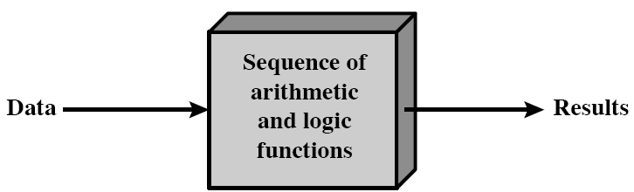
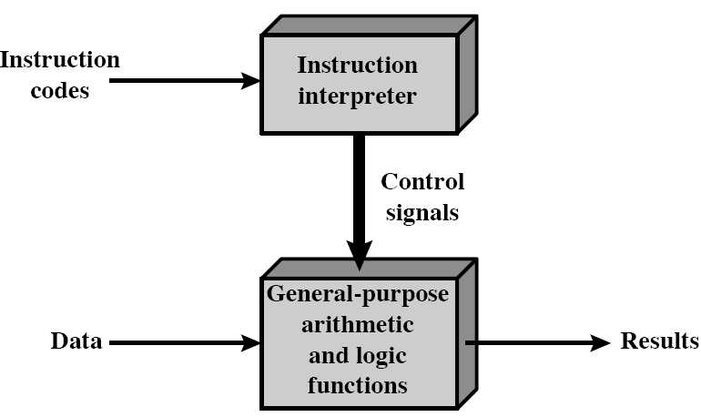
Ch.3-3.1
Programming in hardware and software

Slide 4
Ch.3-3.1
CPU

Slide 5
Ch.3-3.1
Main Components
  the Central Processing Unit-CPU
  Input/output---I/O
  Main memory
  System bus

Slide 6
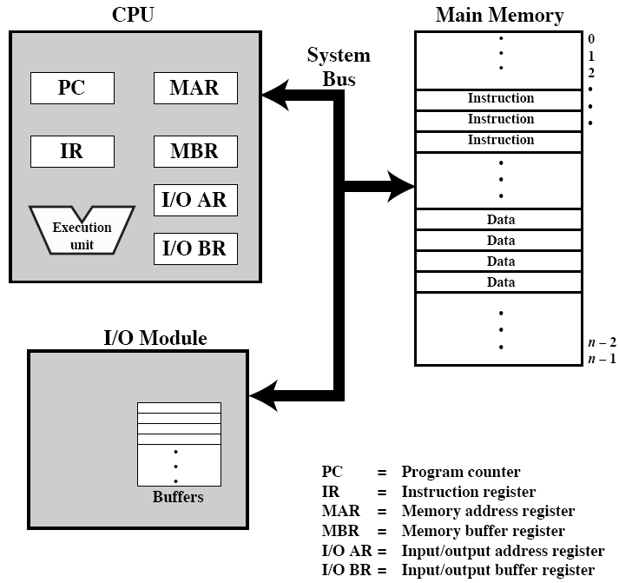

Slide 7
3.2 Computer Function
Basic function of a computer is executing program (a sequence of instructions), to complete special tasks
CPU is a component of executing instruction
  The CPU time of processing an instruction is called Instruction Cycle
  An execution of instruction can be simply viewed as two steps:
    Fetch instruction - Fetch cycle
    execute instruction - Execute cycle

Slide 8
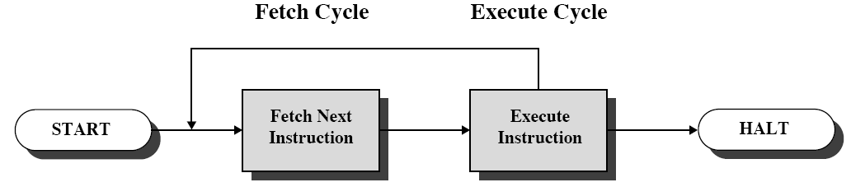
Ch.3-3.2
Instruction Cycle
  Fetch
  Execute

Slide 9
Ch.3-3.2
Fetch Cycle
  Processor fetches instruction from memory location pointed to by PC
  Increment PC
    Unless told otherwise
  Instruction loaded into Instruction Register (IR)
  Processor interprets instruction and performs required actions

Slide 10
Ch.3-3.2
Operations in Execute Cycle
  Processor-memory
    data transfer between CPU and main memory
  Processor- I/O
    Data transfer between CPU and I/O module
  Data processing
    Some arithmetic or logical operation on data
  Control
    Alteration of sequence of operations
    e.g. jump
  Combination of above

Slide 11
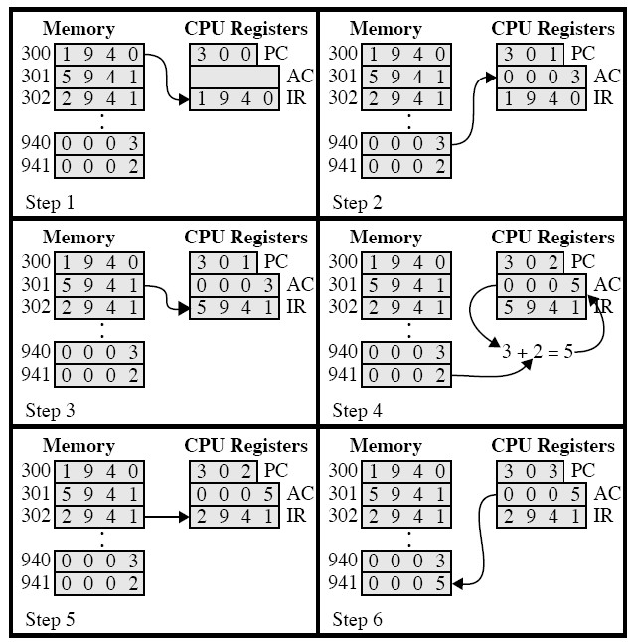
Ch.3-3.2
Memory unit 16-bit
1:load
2:store
5:add

Slide 12
Ch.3-3.2
Flow of an Instruction
  Instruction address calculation
  Instruction fetch
  Instruction operation decoding
  operand address calculation
  Operand fetch
  Data operation
  Operand storage

Slide 13
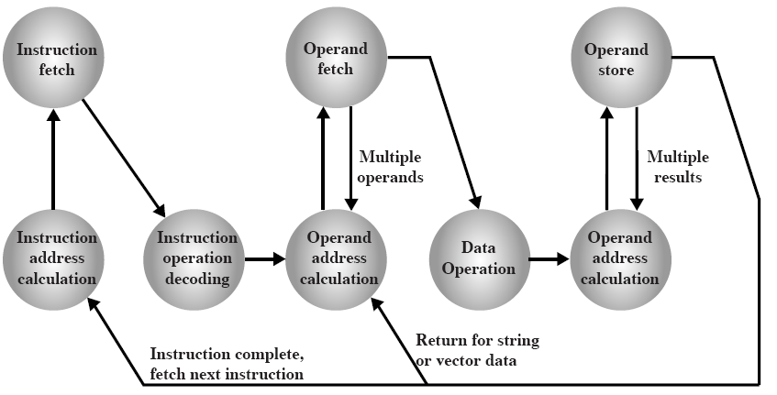
Ch.3-3.2

Slide 14
Ch.3-3.2
Interrupts
  Def.：a mechanism allowing other module to break CPU executing sequence
  The objective of interrupts
    to improve the utility of the CPU
    to allow CPU to process urgent events

Slide 15
Ch.3-3.2
Types of interruption
  Program
    e.g. overflow, division by zero，illegal instruction， outside reference
  Timer
    Generated by internal processor timer
    Used in pre-emptive multi-tasking?
  I/O
    from I/O controller
  Hardware failure
    e.g. memory parity error

Slide 16
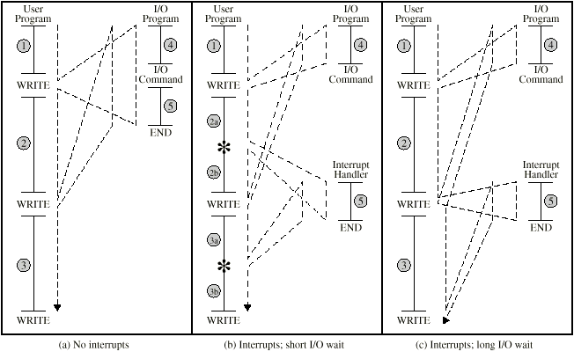
Ch.3-3.2

Slide 17
Ch.3-3.2
If interrupt is pending, the processor does the following:
  Suspend execution of the current program being executed and save its context
    Save current context of PC and other data
  Set the PC to starting address of an interrupt handler routine
The user program does not have to contain any special code to accommodate interrupts
The processor and OS are responsible for suspending the user program and resuming it

Slide 18
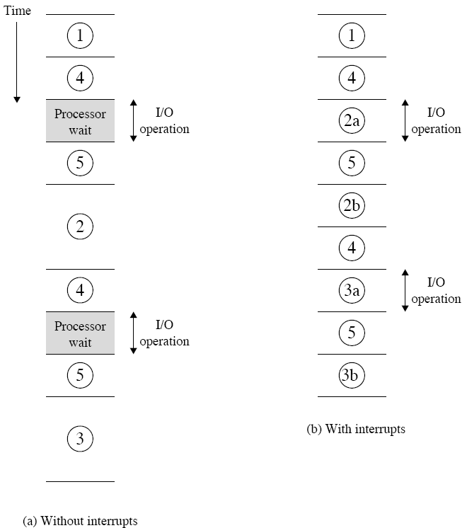
Ch.3-3.2
Program Timing: short I/O wait

Slide 19
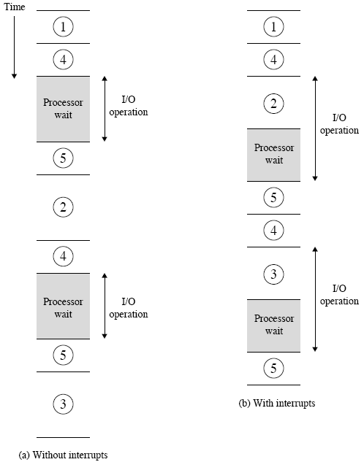
Ch.3-3.2
Program Timing: long I/O wait

Slide 20
Ch.3-3.2
An interrupt cycle is added to instruction cycle
  After an instruction cycle, processor checks for interrupt, Indicated by an interrupt signal
  If no interrupt, fetch next instruction
  If interrupt :
    Suspend execution of current program
    Save context
    Set PC to start address of interrupt handler routine
    Process interrupt
    Restore context and continue interrupted program

Slide 21
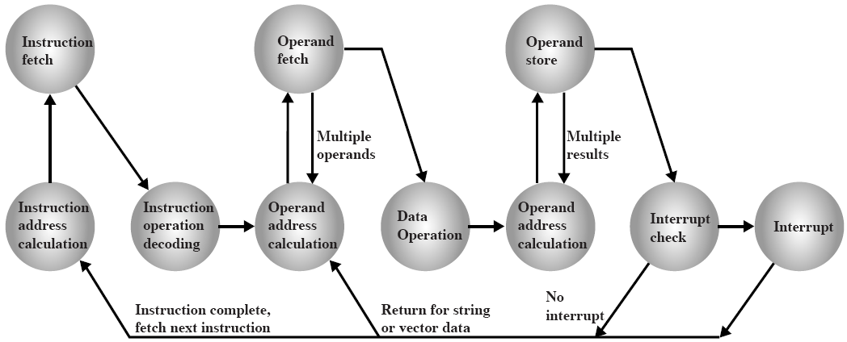
Ch.3-3.2

Slide 22
Ch.3-3.2
Multiple Interrupts
  Def.: multiple interrupts occur at the same time
  The methods of processing multiple interrupt:
    Disable interrupts
      Processor will ignore further interrupts whilst processing one interrupt
      Interrupts remain pending and are checked after first interrupt has been processed
      Interrupts handled in sequence as they occur
    Define priorities
      Low priority interrupts can be interrupted by higher priority interrupts
      When higher priority interrupt has been processed, processor returns to previous interrupt

Slide 23
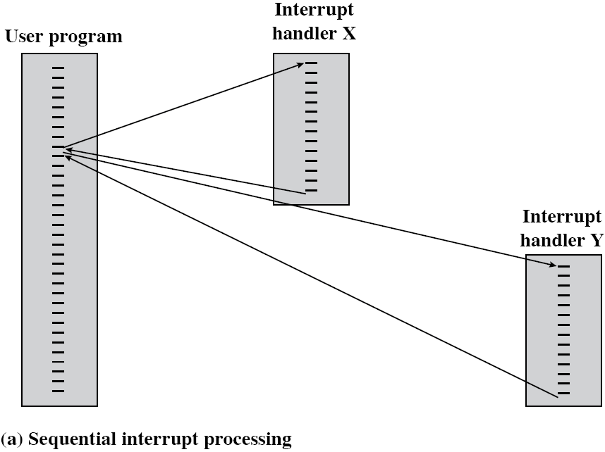
Ch.3-3.2

Slide 24
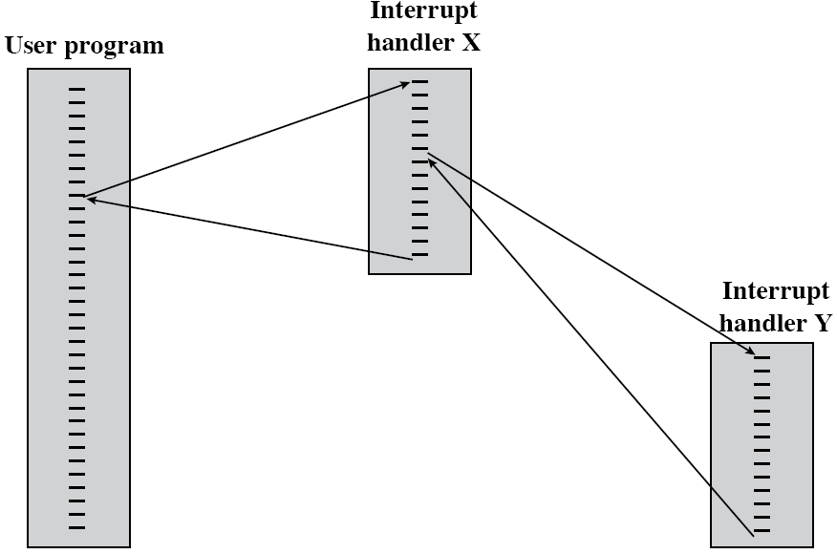
Ch.3-3.2

Slide 25
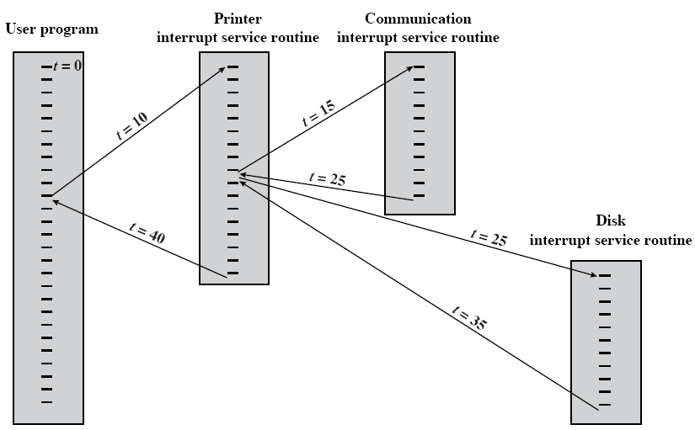
Ch.3-3.2
4
t =20
5
2

Slide 26
Ch.3-3.2
I/O function
  Exchange data directly with the processor
  Exchange data directly with the memory, in some case
    Direct memory access (DMA) - chapter 7

Slide 27
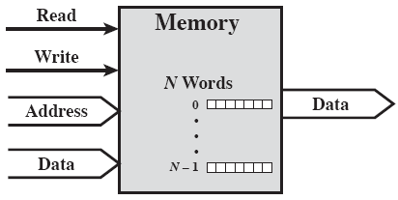
3.3 Interconnection structures
Def.: The collection of paths connecting the various modules
(a) Memory

Slide 28
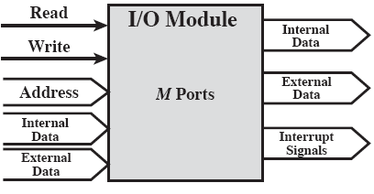
Ch.3-3.3
(b) I/O modules
  Port: Each of the interface to an external device
  Give each a unique address (e.g. 0,1,…,M-1)

Slide 29
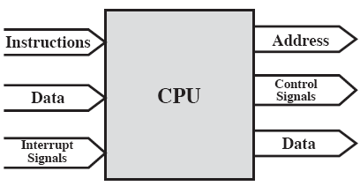
Ch.3-3.3
(c) CPU

Slide 30
Ch.3-3.3
Types of transfer:
  Memory to processor
  Processor to memory
  I/O to processor
  Processor to I/O
  I/O to or from memory - DMA

Slide 31
3.4 Bus interconnection
Def.: communication paths connecting two or more components
Often grouped
  A number of channels in one bus, e.g. 32 bit data bus is 32 separate single bit channels
  Bus width: the number of lines
Key feature of bus: providing shared transferring media
Bus types: system bus, peripheral buses,
internal bus
  System Bus: bus connecting main components of computer
    Data Bus, Address Bus, Control Bus

Slide 32
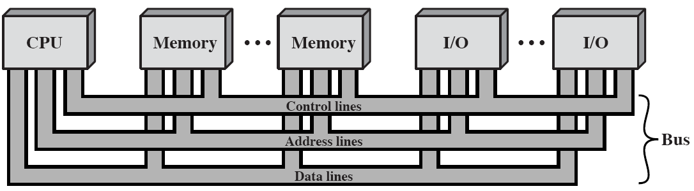
Ch.3-3.4
Bus Interconnection Scheme

Slide 33
Ch.3-3.4
Data bus
  Function: carry data
    Remember that there is no difference between “data” and “instruction” at this level
    Each line can carry only 1 bit at a time
  Data bus width is a key factor in determining of system performance
    8, 16, 32, 64 bit
  Machine word-length: The most binary bits which machine can process in the integer operation
    Data bus width = Machine word-length
    = major Register length

Slide 34
Ch.3-3.4
Address bus
  Function: identify the source or destination of data
    e.g. CPU needs to read an instruction (data) from a given location in memory
  Address bus width determines maximum memory capacity of system
    e.g. 8088 has 20 bit address bus giving 1M address space

Slide 35
Ch.3-3.4
Control bus
  Function: transfer control signals
    Control use of data and address bus
  Control signals: command and timing information
    Memory read/write signal
    I/O read/write
    Transfer ACK
    Bus Request
    Bus grant
    Interrupt request & ACK
    Clock signals
    Reset

Slide 36
Ch.3-3.4
Physical structure of bus
  What do buses look like?
    Parallel lines on circuit boards
    Ribbon cables
    Strip connectors on mother boards
      e.g. PCI
    Sets of wires

Slide 37
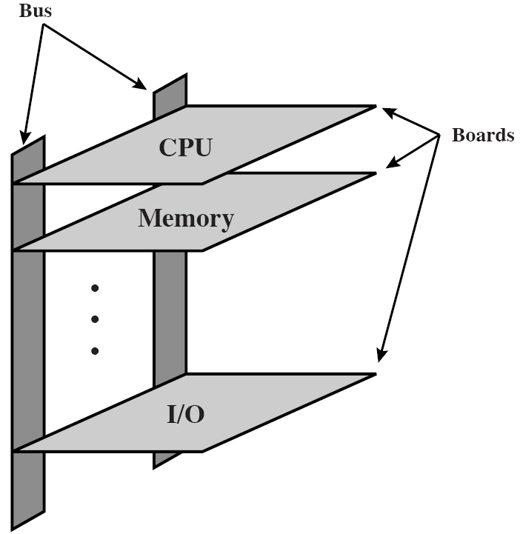
Ch.3-3.4

Slide 38
Ch.3-3.4
Multiple-bus Hierarchies
  Single Bus Problems
    Lots of devices on one bus leads to:
      Propagation delays（bottleneck）
        More device mean more long bus, and this leads greater delay. Long data paths mean that co-ordination of bus use can adversely affect performance
        If aggregate data transfer approaches bus capacity
  Most systems use multiple buses to overcome these problems

Slide 39
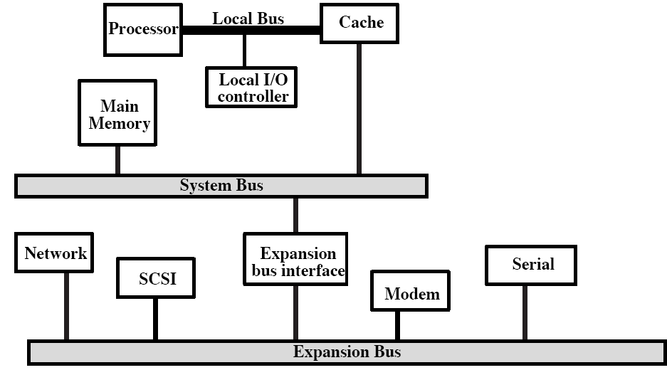
Ch.3-3.4
Traditional bus architecture

Slide 40
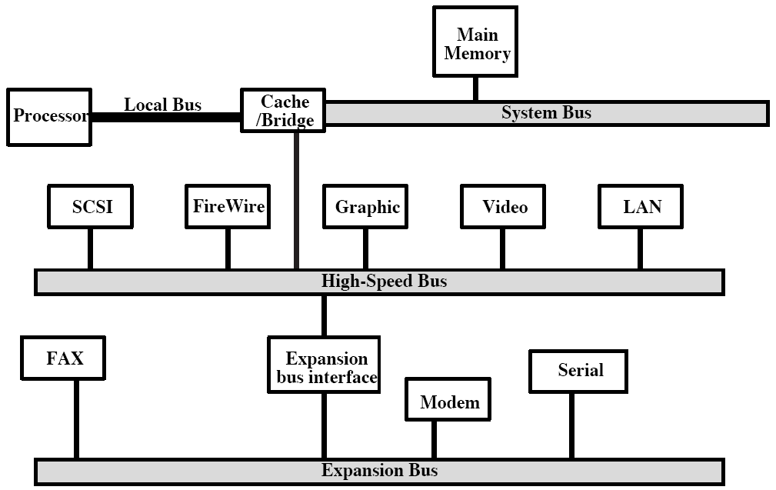
Ch.3-3.4
High-performance bus

Slide 41
Ch.3-3.4
Elements of Bus Design
⬥ Type  Bus width
  Dedicated address
  Multiplexed data
⬥ Method of arbitration  Data transfer types
  Centralized read
  Distributed write
⬥ Timing read-modify-write
  Synchronous read-after-write
  Asynchronous block

Slide 42
Ch.3-3.4
Bus Types
Dedicated Bus:
  Multiple buses, e.g, Separate data & address lines
  Advantage: high throughput
  Disadvantage: scale and cost increases
Multiplexed Bus:
  Time multiplexing, shared lines
  Address valid or data valid control line
  Advantage - fewer lines, space, cost
  Disadvantages
    More complex control
    Ultimate performance

Slide 43
Ch.3-3.4
Bus Arbitration
More than one module using the bus
  e.g. CPU and DMA controller
Only one module may control bus at one time
Arbitration method:
  Distributed: no centralized controller, every module contains a access control logic
  Centralized: a bus controller/arbiter is responsible for bus usage and time. A separate module or part of CPU
    Separate request
    Chain polling
    Counter timing polling

Slide 44
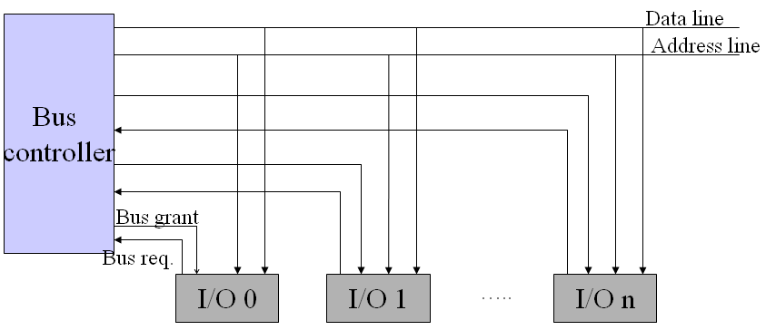
Ch.3-3.4
  Separate request
Separate Request
Adv.: rapid response, flexible priority
Disadv.: too many lines, complex control

Slide 45
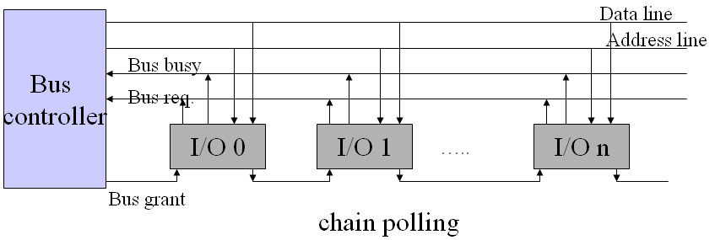
Ch.3-3.4
  Chain polling
Adv.: scalable
Disadv.: sensitive to circuit failure

Slide 46
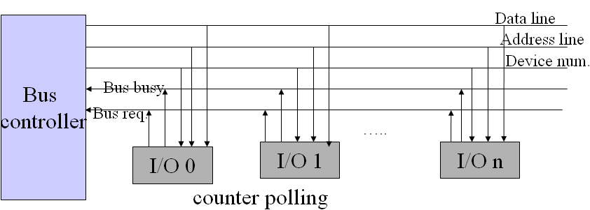
Ch.3-3.4
  Counter polling
Adv.: flexible priority, insensitive to circuit failure
Disadv.: complex control

Slide 47
Ch.3-3.4
Communication Control Modes of Bus
  Communication control: addressing how to start and end transmission, how to coordinate master and slave module
  According to timing, four communication modes can usually be used
    Synchronous
    Asynchronous
    Half-synchronous
    Separated

Slide 48
Ch.3-3.4
Timing
  Def.: the way in which events are coordination on bus
  Synchronous timing: the occurrence of events is determined by clock signals
    Control bus includes clock line
    A single 1-0 transmission is a bus cycle or bus cycle
    All devices can read clock line
    Usually sync on leading edge
    Usually a single cycle for an event???
  Asynchronous timing: the occurrence of one event on a bus follows and depends on the occurrence of a previous event
  Half-synchronous
  Separate Communication

Slide 49
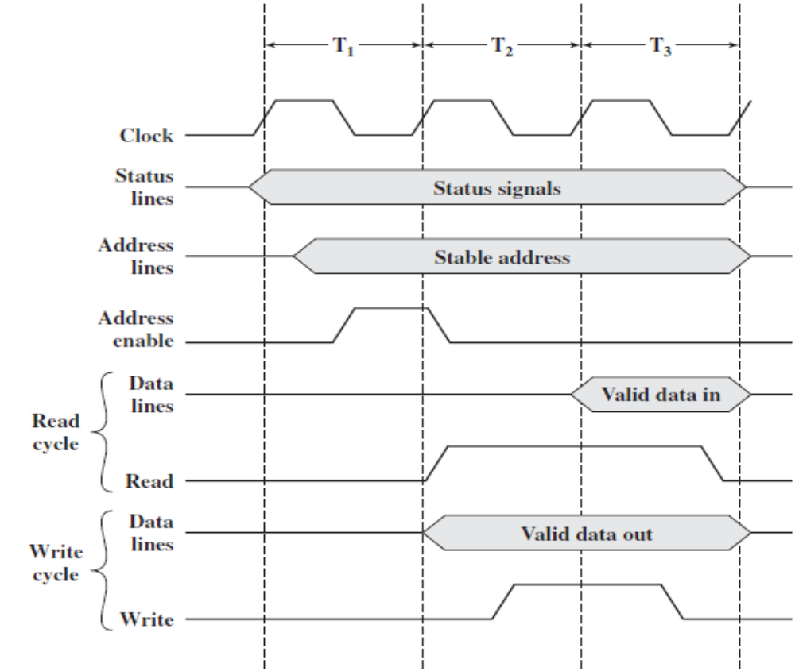
Ch.3-3.4
Adv: simple, easy to implement
Disadv: inflexible, bottleneck
Synchronous Timing Diagram

Slide 50
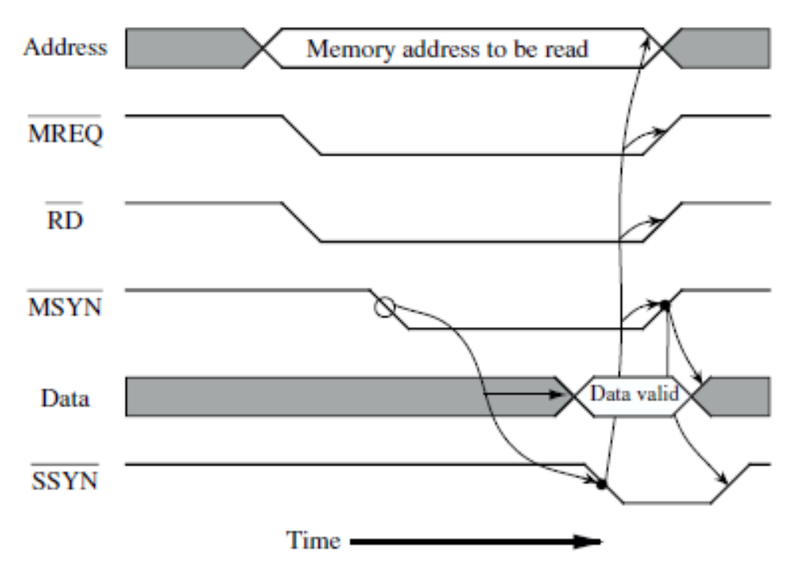
Ch.3-3.4
Adv: request-response, allowing fast and slow devices
Disadv: control complex
Asynchronous Timing Diagram
CPU
Main
Memory

Slide 51
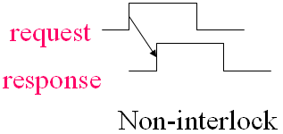
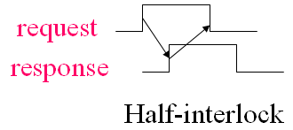
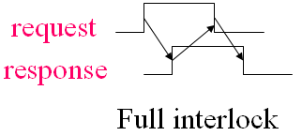
Ch.3-3.4
Types of Asynchronous Communication
  Non-interlock
  Half-interlock
  Full interlock

Slide 52
Ch.3-3.4
Half-synchronous Communication
  Clock is needed
  Wait line is needed
  Allowing various speed modules to communicate harmoniously
  Used for connecting low speed and larger speed difference devices

Slide 53
Ch.3-3.4
Separate Communication
  Basic idea is:
    Separate bus cycle into two sub-cycles
    In the first sub-cycle, master puts command, address and other information into the bus, then abandons the bus
    In the second sub-cycle, slave begins to prepare data (select, decode, load), then applies the bus and sends the data
  Advantage: avoiding bus idle waiting
  Used for large computer

Slide 54
Ch.3-3.4
Bus width
  The width of data bus has an impact on system performance, bit
  The width of address bus has an impact on system capacity, bit
Bus bandwidth
  The transmitting rate of bus, b/s

Slide 55
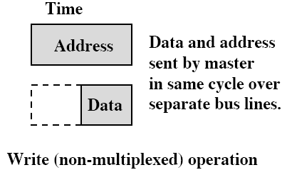
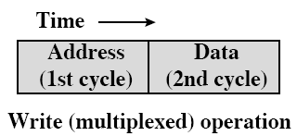
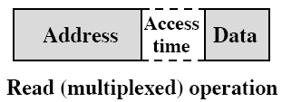
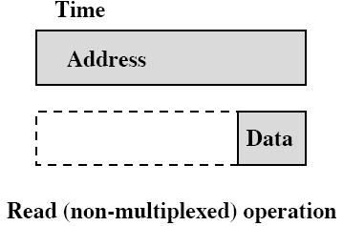
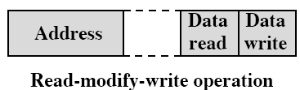
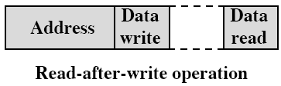
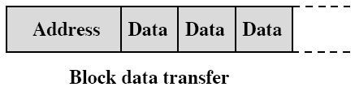
Ch.3-3.4
Data transfer type
(a)
(c)
(b)
(e)
(d)
(f)
(g)

Slide 56
3.5 PCI
PCI (Peripheral Component Interconnection)：also called high speed I/O bus
  Intel released to public
CPU-independent, high-bandwidth, inexpensive
64 bit，264Mbps/4.2Gbps
Can interconnect to other buses
Centralized control and syn. Timing, hidden arbitration

Slide 57
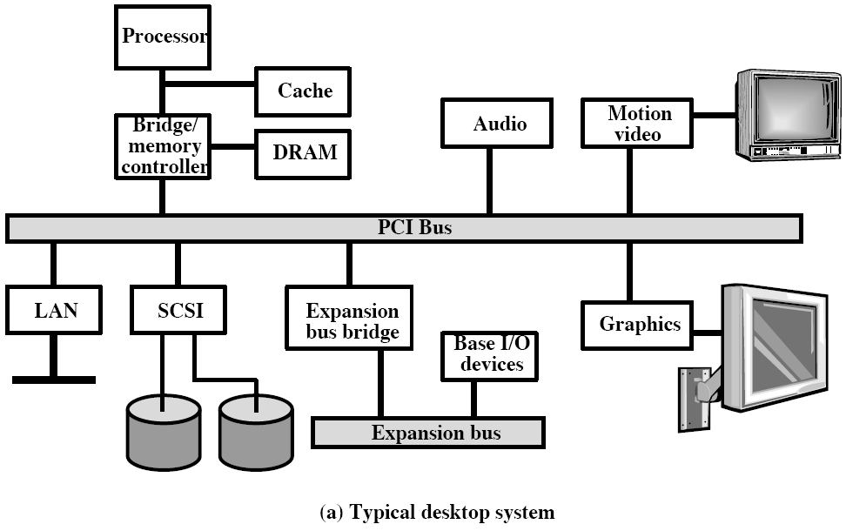
Ch.3-3.5

Slide 58
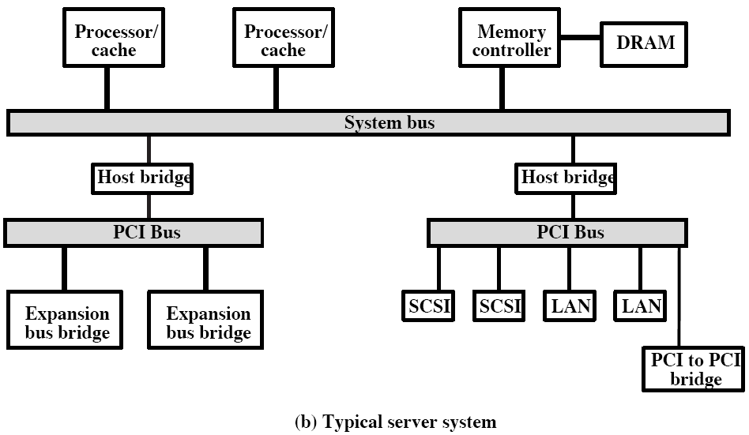
Ch.3-3.5

Slide 59
Supplement
ISA (industrial standard architecture)
  Intel,16bit, also called AT bus,8MHz,16MB/s
  Low performance bus, CPU participant
EISA (extended industrial standard architecture)
  ISA Compatible, 32bit
  8MHz,33MB/s
VL-BUS:
  local bus standard proposed by video electronic standard association
  Evolved from CPU bus,33MHz,32bit
  High-performance bus used for CPU and high speed devices
USB (Universal Serial Bus)
  Flexible
  faster
  Connector with low cost cable and hub

Slide 60
Vocabulary
Hardwired program:硬布线编程
Interrupt request:中断请求
Interrupt handler routine:中断处理程序
Multiple interrupts:多重中断
DMA(direct memory access):直接存储器访问
Port：端口
Module:模块
Fast Ethernet：快速以太网
Packet-switching network：分组交换网

Slide 61
Vocabulary
LAN：局域网
Time(frequency) multiplexing:时(频)分复用
Adapter：适配器
Arbitration:仲裁
Synchronous (Asynchronous) timing:同（异）步时序
Master (slave) synchronous：主（辅）同步
Multiprogramming system：多道程序系统
PCI(peripheral component interconnect):外设互连（总线）

Slide 62
Key points
  Interrupt and instruction cycles
  Multiple interrupts
  System bus
  Multiple bus hierarchy
  Key elements of bus

Slide 63
Exercises
1 什么是总线？总线传输有何特点？
2 什么是系统总线？它分为哪几类？各有什么作用？分别是单向的还是双向的？它们与机器字长、存储字长及存储单元数有何关系？
3 常见的集中式总线控制有几种？各有何特点？ 哪种方式响应时间最快？哪种方式对电路故障最敏感？
4 常见的总线通信方式有哪些？各有什么特点？
5 某同步总线的时钟频率为100MHz，地址/数据线复用，宽 度为32位，每传输一个地址或者数据占用一个时钟周期。若该总线支持猝发（块）传输方式，块大小为16B，则一次“主存写”总线事务传输128位数据所需时间至少为多少？
6. P131页 3.1&3.2 P133页 3.12

Slide 64
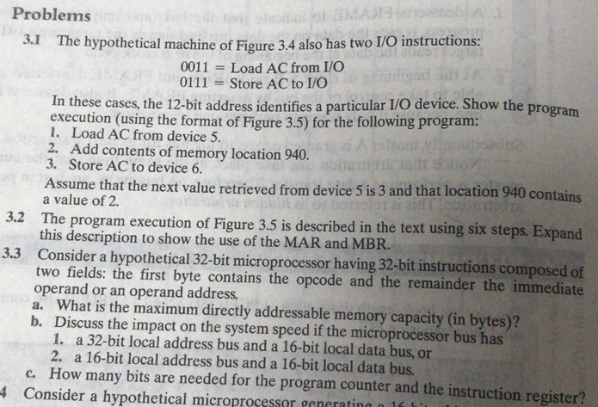

Slide 65
Exercises
6 某同步总线的时钟频率为100MHz，地址/数据线复用，宽度为32位，每传输一个地址或者数据占用一个时钟周期。若该总线支持猝发（块）传输方式，块大小为16B，则一次“主存写”总线事务传输128位数据所需时间至少为多少？

